Slide 1
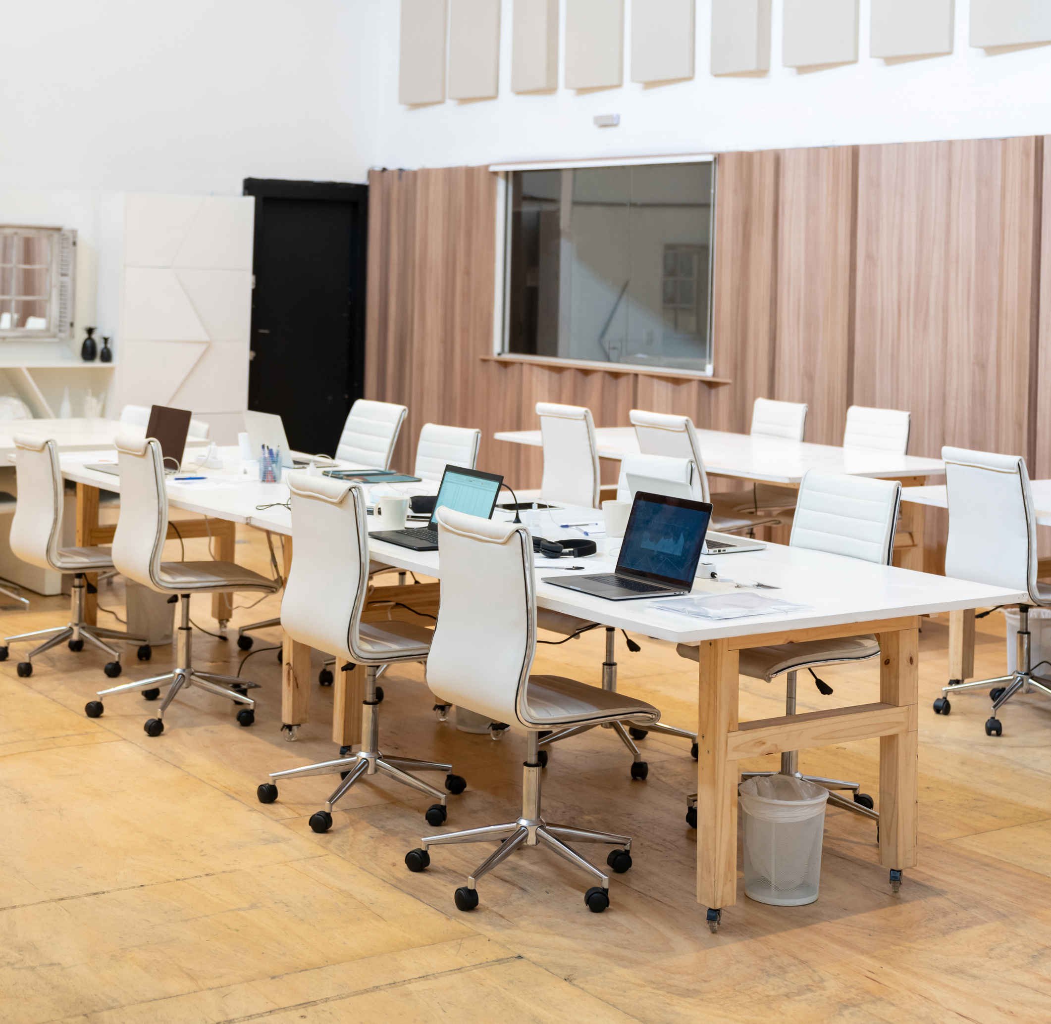



TECHNOLOGICAL UNIVERSITY
OF THE PHILIPPINES - MANILA
CoZone:
ENHANCING COWORKING SPACE ACCESS WITH WEB-BASED RESERVATION SYSTEM

Slide 2
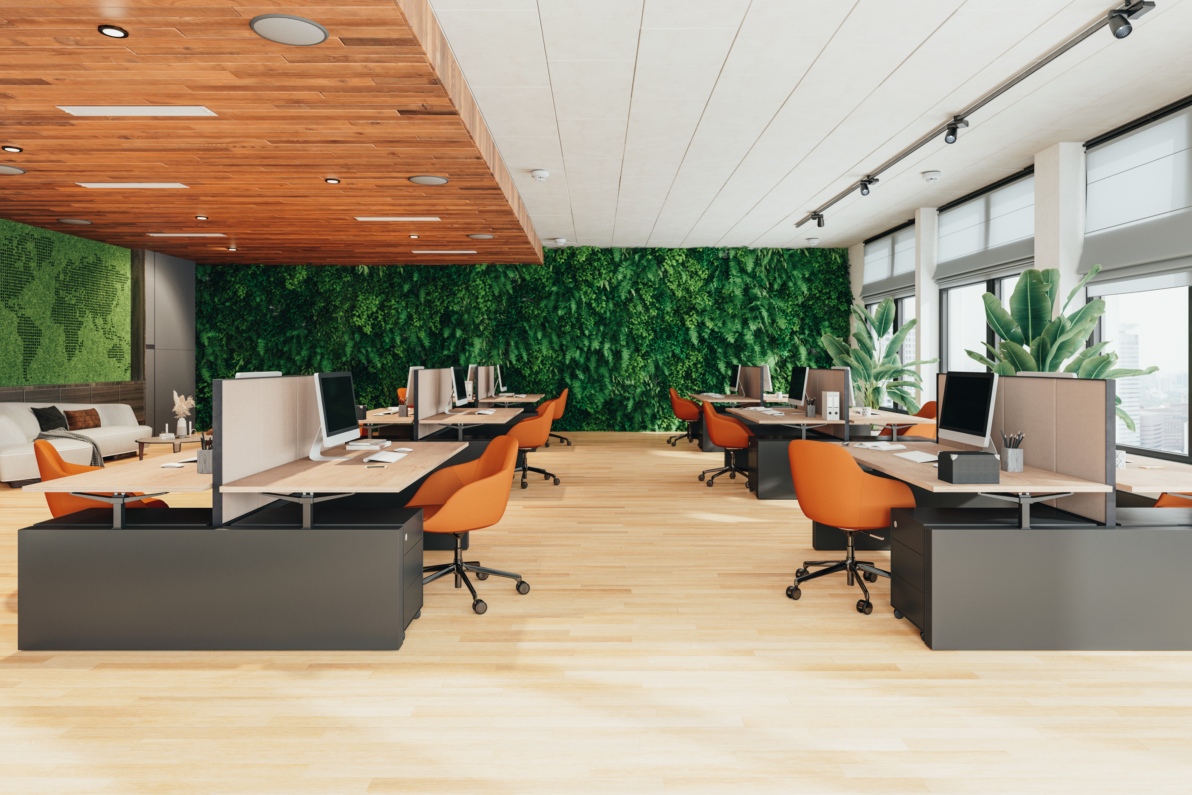


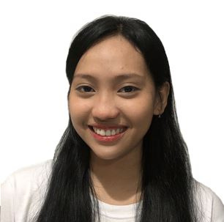
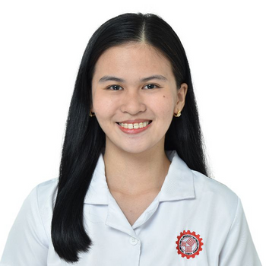
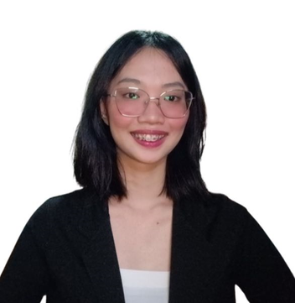
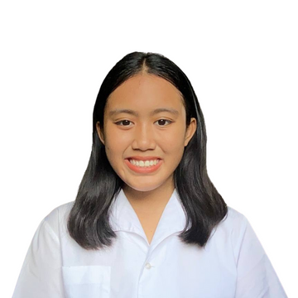
Andal, Maria Eloissa M.
Balatero, Jay-Ann Angela D,
Caguiat, Tara Francesca L.
Enriquez, Signet B.
Recaña, Angel Cyrhen P.
Lead Programmer
Lead Back-End
Lead Front-End
Lead Researcher,
Documentation
Project Manager
MEMBERS

Slide 3


INTRODUCTION

Slide 4



BACKGROUND OF THE STUDY
“C-BASE”
the concept of coworking was established by 17 computer engineers
BERNARD DEKOVEN
— first used the word "coworking"
BRAD NEUBERG
— opened the first official coworking space

Slide 5
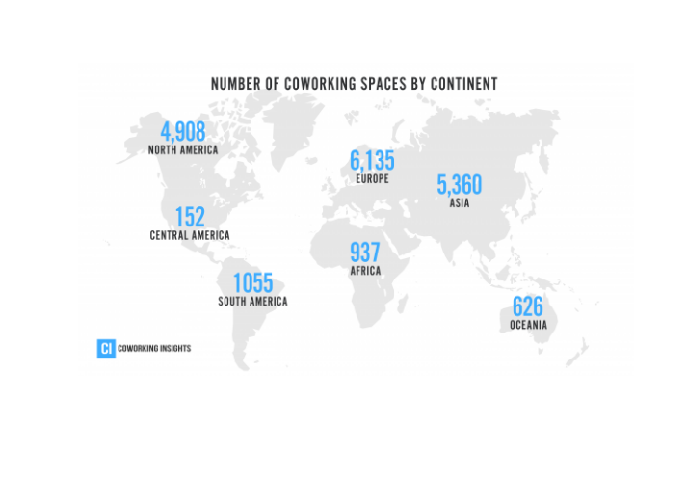
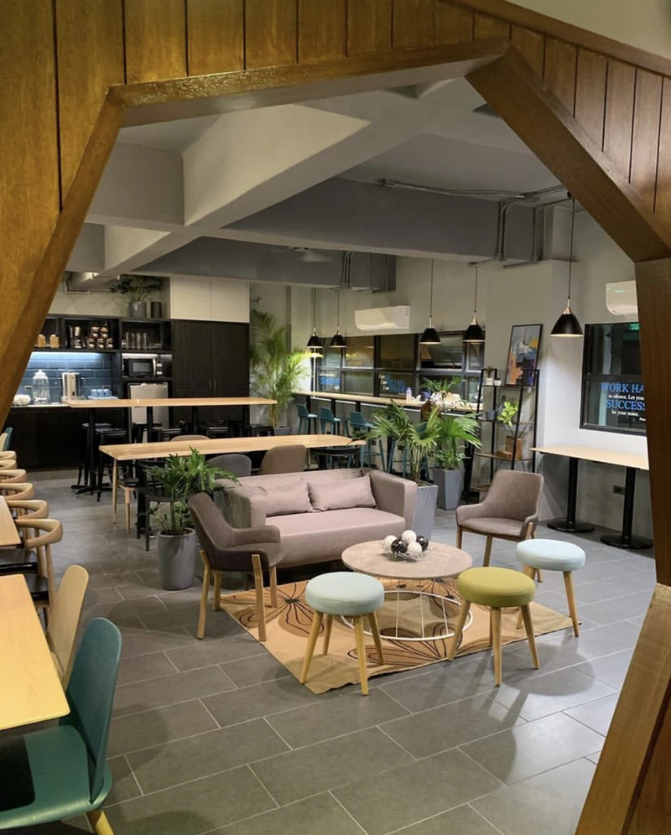
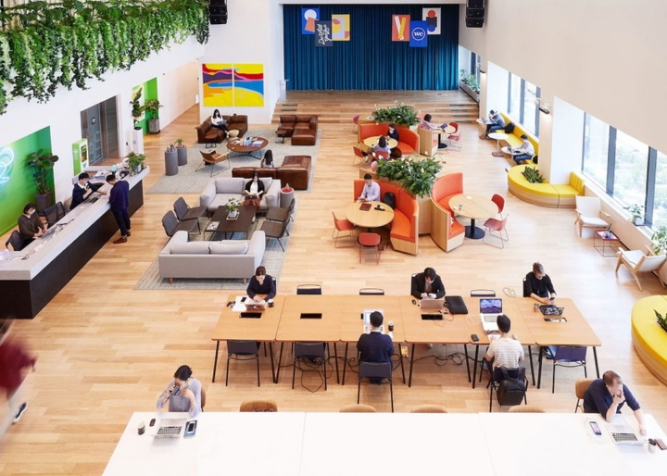
INTRODUCTION
2024: Coworking Spaces is expected to double and exceed more than
40,000 locations
Popularity and Impact
Sustainability in Coworking
Rise of Digital Nomadism
255 Coworking Spaces in Philippines
— 100 listed in Metro Manila —

Slide 6
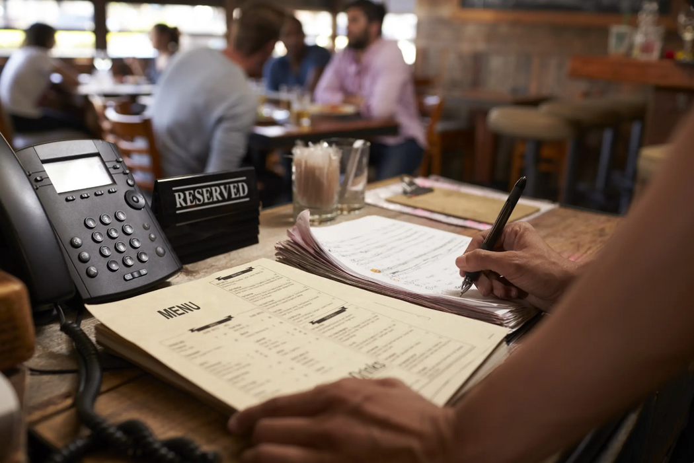
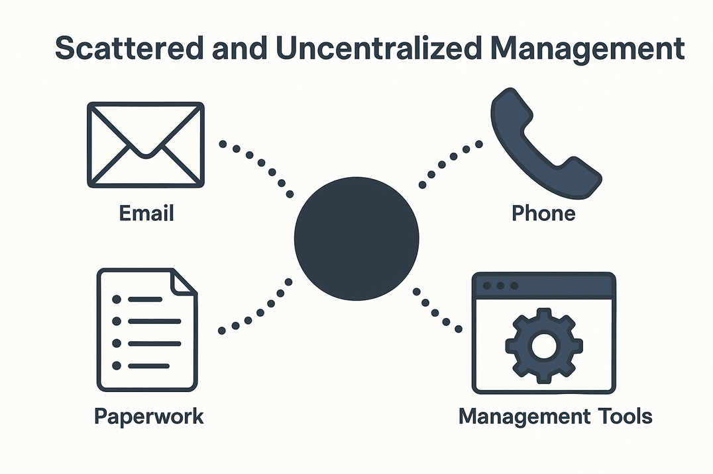
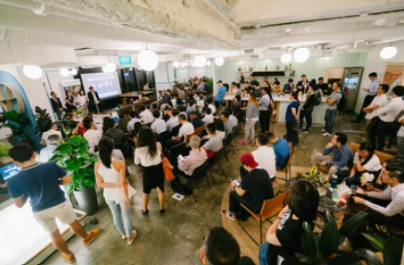
INTRODUCTION
Lack of Real-Time Availability Information
Scattered and Uncentralized Management
Manual Booking System

Slide 7

OBJECTIVES OF THE STUDY
To develop “CoZone”, a web-based reservation system that manages coworking spaces, catering to clients who need occasional access to professional work environments.
GENERAL OBJECTIVES

Slide 8
METHODOLOGY

Slide 9
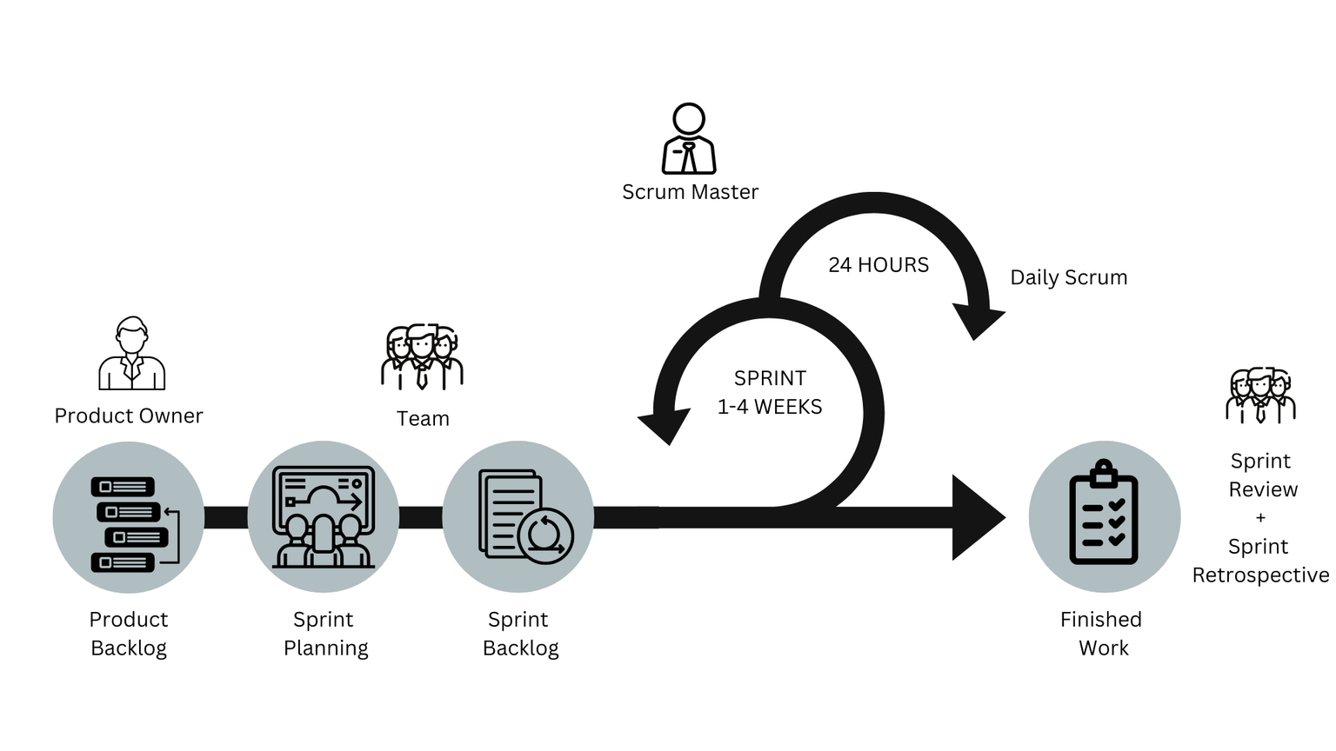
PROJECT DESIGN
AGILE “SCRUM” DIAGRAM

Slide 10
DATA
PROCEDURE
Simulated Data
SAMPLE DATA | Coworking space listings, User accounts, Booking details and Transaction records
USABILITY TESTING | 30 target users
SPRINT 1 | Requirement analysis and UI design
SPRINT 2 | Client-side features
SPRINT 3 | Lessor-side features
SPRINT 4 | Admin dashboard

Slide 11








PROCEDURE
FRONTEND
BACKEND
DATABASE
API
PAYMONGO
GOOGLE MAPS
VERSION CONTROL
UI TOOLS
IDE
HOSTING

Slide 12
ANALYSIS
Functional suitability – tested via task-based scenarios and test cases for booking, filtering, and user management.
Reliability – assessed through repeated use under different conditions, including error handling, transaction stability, and uptime performance.

Slide 13
RESULTS

Slide 14
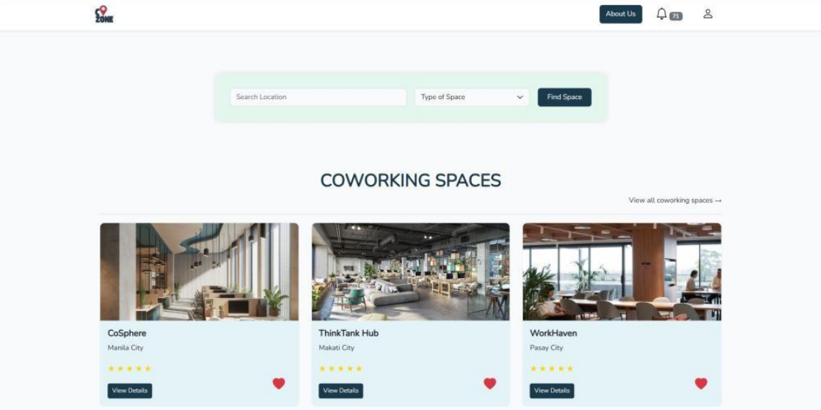
INTERFACE
CLIENT SIDE
Home Page

Slide 15
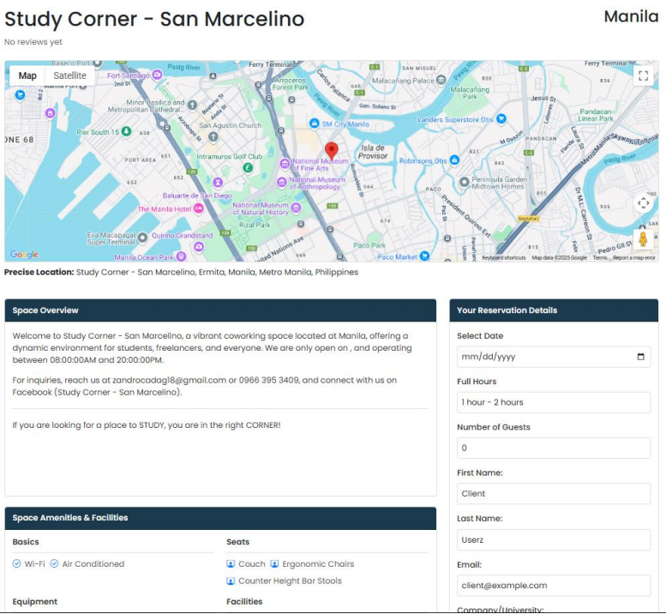
INTERFACE
CLIENT SIDE
View Coworking Space & Reservation Form

Slide 16
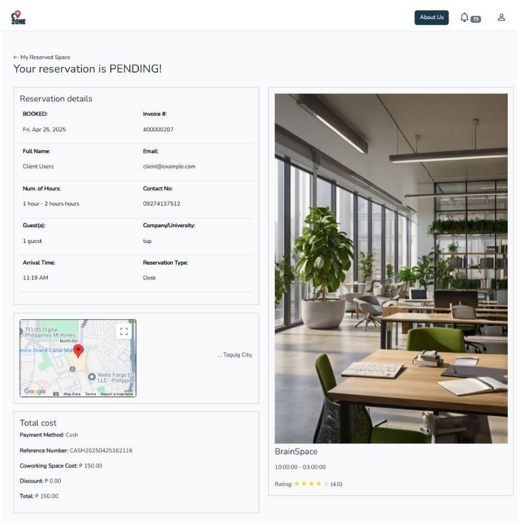
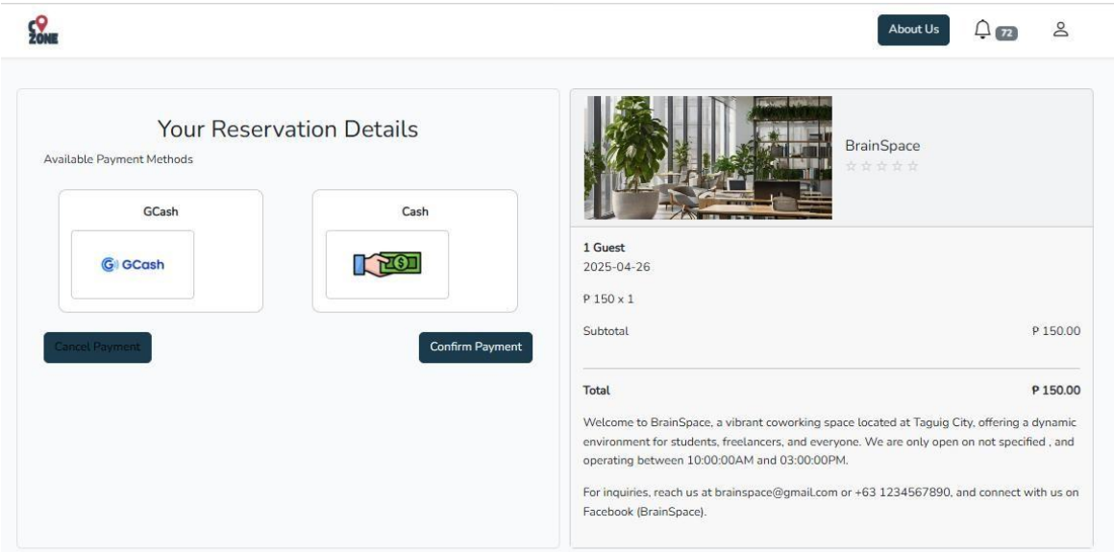
INTERFACE
CLIENT SIDE
Payment Method
Successful Reservation

Slide 17
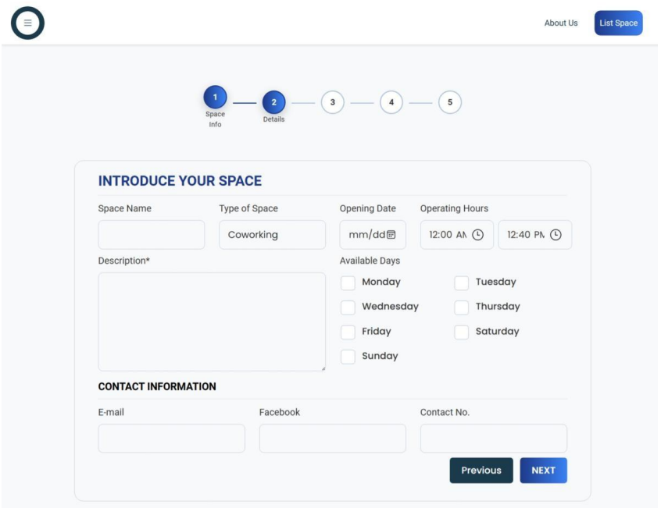
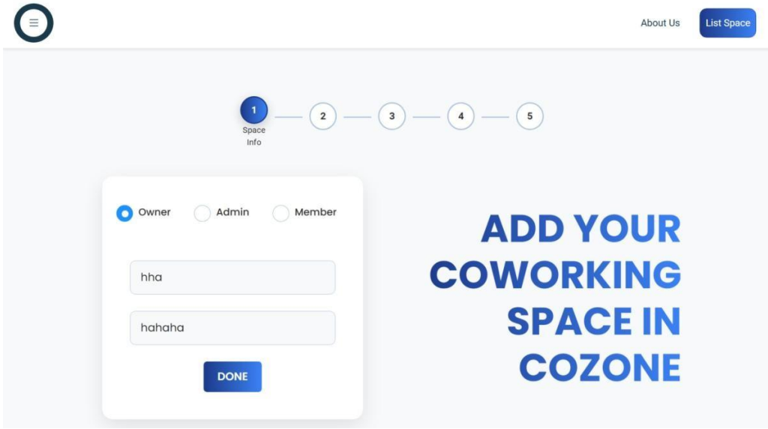
INTERFACE
LESSOR SIDE
Listing Space

Slide 18
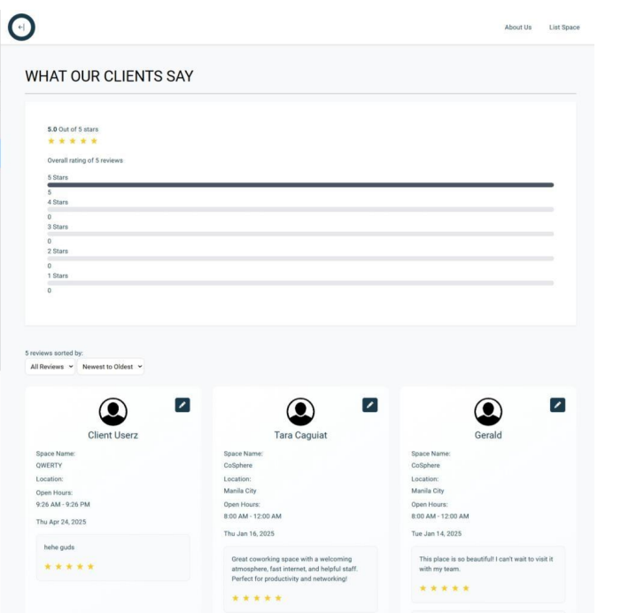
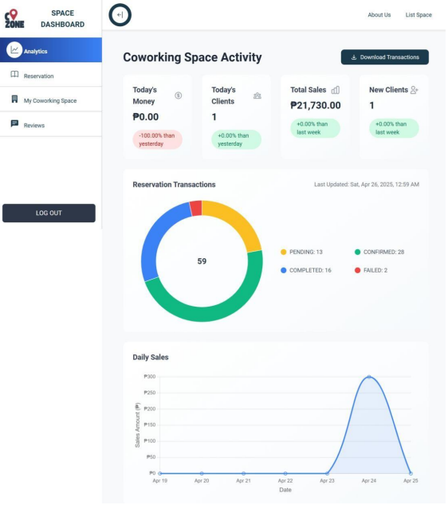
INTERFACE
LESSOR SIDE
Feedback and Ratings
Lessor Analytics

Slide 19
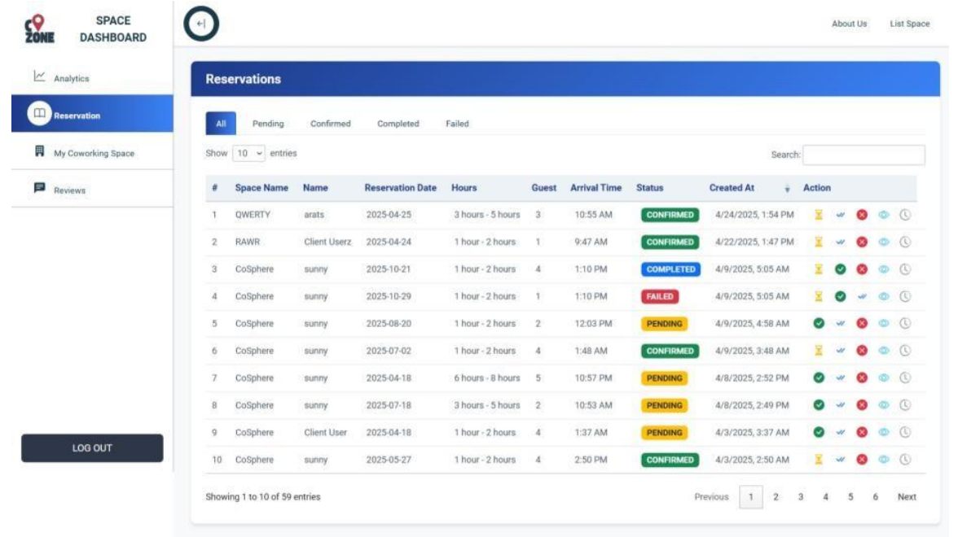
INTERFACE
LESSOR SIDE
Reservations

Slide 20
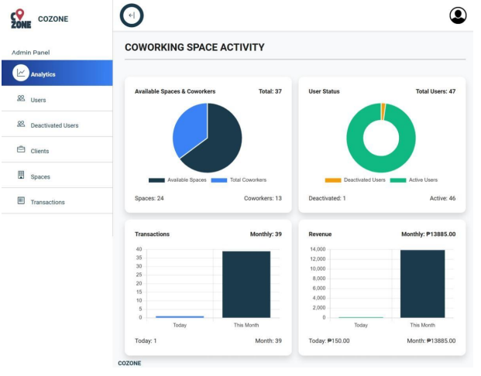
INTERFACE
ADMIN SIDE
System Admin Analytics

Slide 21
PROJECT EVALUATION
Functional Suitability Evaluation Result
CRITERIA | WEIGHTED MEAN | DESCRIPTIVE RATING
Functional Completeness | 3.68 | Highly Acceptable
Functional Correctness | 3.82 | Highly Acceptable
Functional Appropriateness | 3.88 | Highly Acceptable
Overall Weighted Mean | 3.79 | Highly Acceptable

Slide 22
PROJECT EVALUATION
Reliability Evaluation Result
CRITERIA | WEIGHTED MEAN | DESCRIPTIVE RATING
Maturity | 3.79 | Highly Acceptable
Availability | 3.74 | Highly Acceptable
Fault Tolerance | 3.74 | Highly Acceptable
Recoverability | 3.74 | Highly Acceptable
Overall Weighted Mean | 3.75 | Highly Acceptable

Slide 23
PROJECT EVALUATION
Software Evaluation Results Summary
CRITERIA | DESCRIPTIVE RATING
Functional Suitability | Highly Acceptable
Reliability | Highly Acceptable
Overall Weighted Mean | Highly Acceptable

Slide 24
DISCUSSIONS

Slide 25
EVALUATION
The successful execution of the tests demonstrates the system's effectiveness and dependability. Its functionality, encompassing completeness, accuracy, and suitability for its intended purpose, was deemed "Highly Acceptable." This indicates that the system effectively delivers the desired outcomes when used under various conditions. In terms of reliability, the system also received a "Highly Acceptable" rating, signifying its consistent performance under expected circumstances for an extended period. This evaluation considers factors such as the system's maturity, continuous availability, ability to handle errors, and capacity for recovery from disruptions.

Slide 26
RECOMMENDATIONS
1
Enhance listing forms for efficiency and customization.
2
Integrate social media login (e.g., Google, Facebook).
Provide virtual assistants or live chat for real-time assistance.
3
4
Send detailed reservation copies to clients via email.

Slide 27
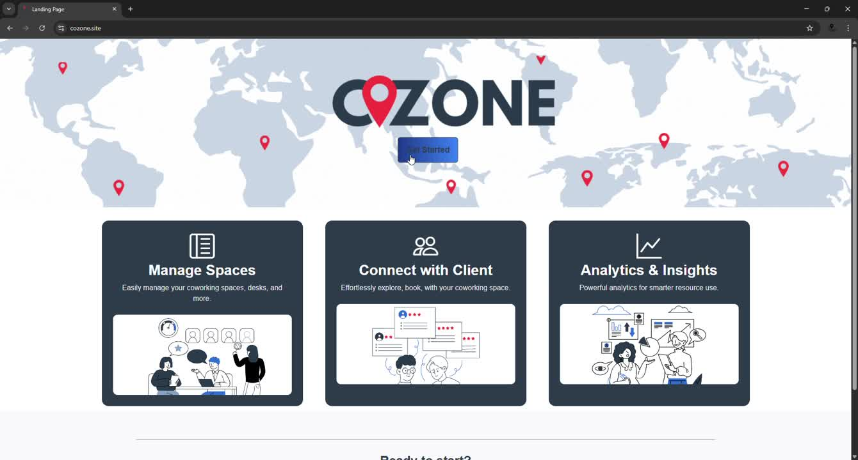
CLIENT SIDE

Slide 28
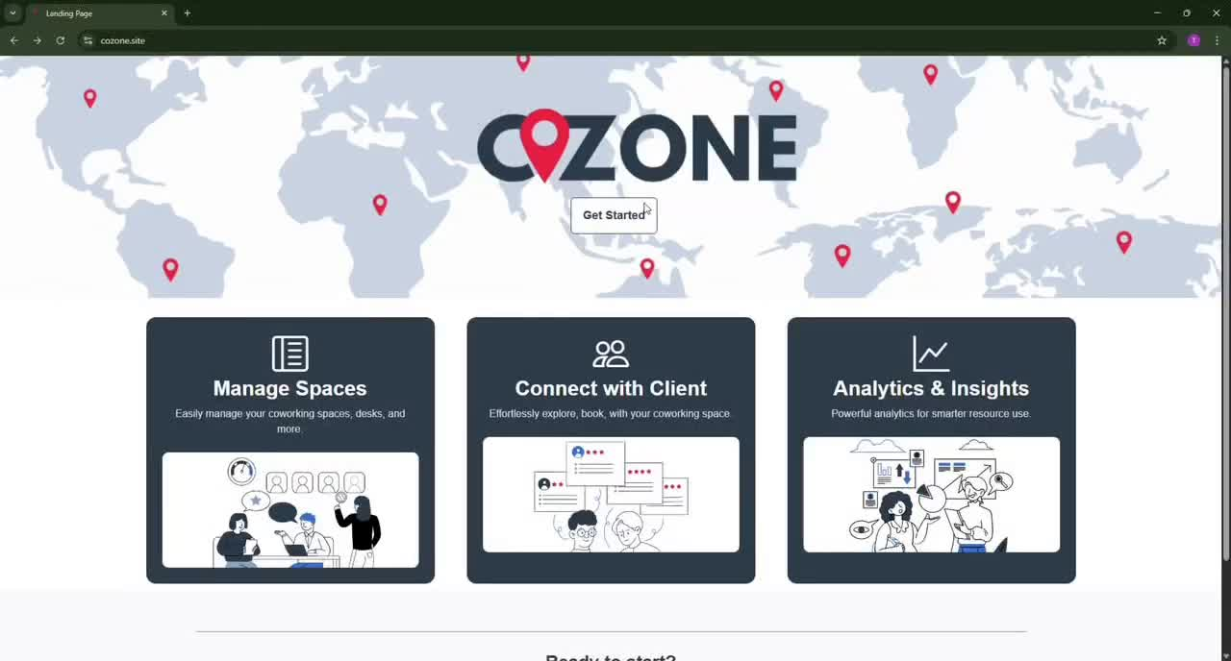
ADMIN SIDE

Slide 29
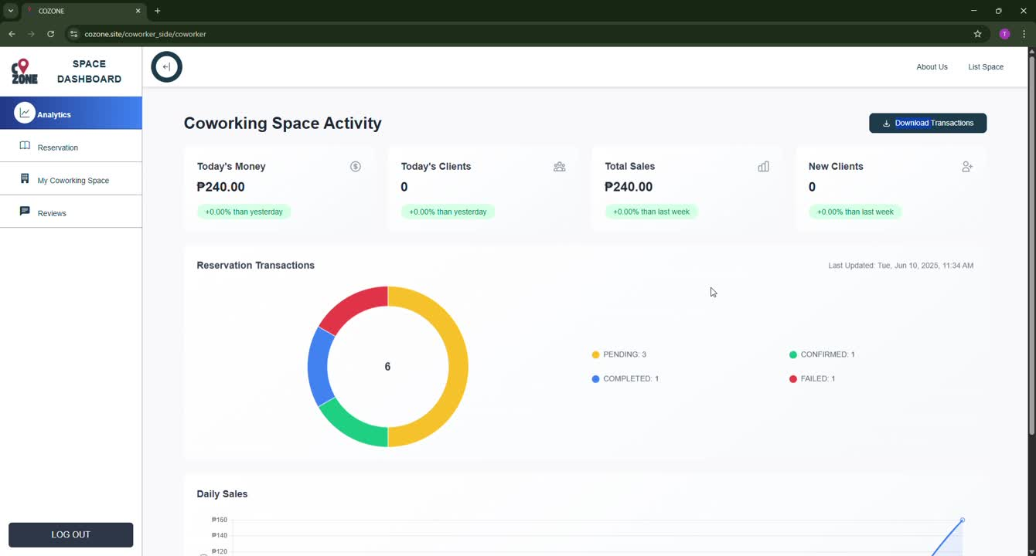
LESSOR SIDE

Slide 30
Thank You!
ANDAL | BALATERO | CAGUIAT | ENRIQUEZ | RECAÑA
BSIS 4A

